Slide 1
HAPI-FHIR for Java Developers
James Agnew
FHIR Developer Days
November 24, 2014

Slide 2

Who am I?
Name: James Agnew
Company: University Health Network
Background:
Software development manager for a large hospital network
Project lead for HAPI for 9 years

Slide 3
About this Presentation
All code samples are available on GitHub in fully working form
HAPI is too big a topic for 1.5 hours :)
so…
I will be around all day Monday to Wednesday to expand on topics I don’t cover here and help you with your projects

Slide 4
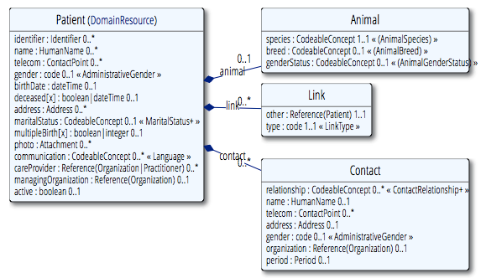
FHIR: A Quick Recap
There are two key parts of FHIR to consider:
The first is a data model for healthcare Resources and supporting Datatypes

Slide 5


FHIR: A Quick Recap (2)
The second is a RESTful API for interacting with that model

Slide 6

The HAPI Project
HAPI started in 2001 as an HL7 v2 Library
Built to support a simple web portal, now used in applications around the world
HL7 v2 - http://hl7api.sourceforge.net FHIR - http://jamesagnew.github.io/hapi-fhir/

Slide 7
HAPI FHIR: What?
Not a client or a server, but a toolkit for building either

Slide 8
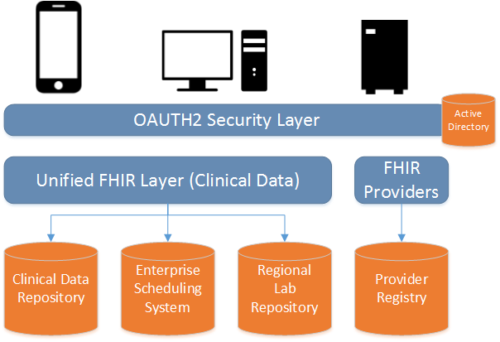
HAPI FHIR: Why?
HAPI FHIR was started to simplify access to our internal data sources

Slide 9
Design Goals
Use Anywhere
Apache 2.0 License for all components
Minimal dependencies
Be Flexible
Loosely coupled, pluggable components
Be Powerful
“Steal” all the best ideas from existing frameworks: JAX-WS, Springframework, .NET FHIR API ☺
..etc..

Slide 10

HAPI: The Key Components
Structure Classes (represent FHIR model)
Parsers (convert model into XML/JSON)
Client (use HTTP to access FHIR servers)
Server (build a FHIR server)
Utilities:
Validator
Narrative Generator

Slide 11
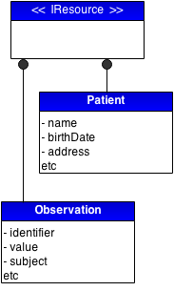
Structures Classes: The FHIR Model
HAPI Defines several sets of classes which form the data model
Resource definition classes implement IResource
Examples: Patient, CarePlan, Encounter, Practitioner, Medication

Slide 12
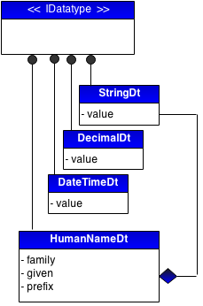
Structures Classes: The FHIR Model (2)
HAPI also defines a class for each data type
Datatype classes are named [name]Dt
Primitive types include: StringDt, AgeDt, BooleanDt
Composite types include: AddressDt, RatioDt

Slide 13
Structures Classes: The FHIR Model (3)
JavaDocs for structures are available here:
http://jamesagnew.github.io/hapi-fhir/apidocs-dstu/index.html

Slide 14
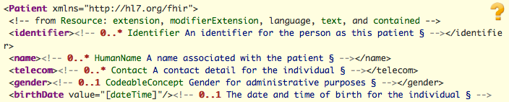
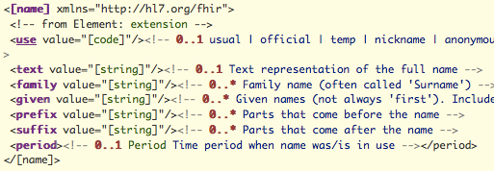
Taking the Structures for a spin
Patient Resource (http://hl7.org/implement/standards/fhir/patient.html)
HumanName Datatype

Slide 15
Taking the Structures for a spin (2)
public class Example01_CreateAPatient {
public static void main(String[] theArgs) {
// Create a resource instance
Patient pat = new Patient();
// Add a "name" element
HumanNameDt name = pat.addName();
name.addFamily("Simpson").addGiven("Homer").addGiven("J");
// Add an "identifier" element
IdentifierDt identifier = pat.addIdentifier();
identifier.setSystem("http://acme.org/MRNs").setValue("7000135");
// Model is designed to be chained
pat.addIdentifier().setLabel("Library Card 12345").setValue("12345");
}
}
https://github.com/jamesagnew/hapi-fhir/tree/master/hapi-fhir-tutorial/skeleton-project

Slide 16
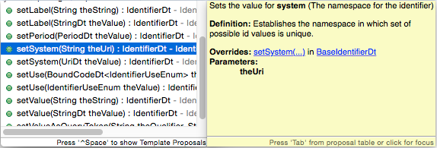
Taking the Structures for a spin (3)
public class Example01_CreateAPatient {
public static void main(String[] theArgs) {
// Create a resource instance
Patient pat = new Patient();
// Add a "name" element
HumanNameDt name = pat.addName();
name.addFamily("Simpson").addGiven("Homer").addGiven("J");

Slide 17
Taking the Structures for a spin (4)
public class Example02_CreateAPatient {
public static void main(String[] theArgs) {
Patient pat = new Patient();
pat.addName().addFamily("Simpson").addGiven("Homer").addGiven("J");
pat.addIdentifier().setSystem("http://acme.org/MRNs").setValue("7000135");
pat.addIdentifier().setLabel("Library Card 12345").setValue("12345");
// Enumerated types are provided for many coded elements
ContactDt contact = pat.addTelecom();
contact.setUse(ContactUseEnum.HOME);
contact.setSystem(ContactSystemEnum.PHONE);
contact.setValue("1 (416) 340-4800");
pat.setGender(AdministrativeGenderCodesEnum.M);
}
}
https://github.com/jamesagnew/hapi-fhir/tree/master/hapi-fhir-tutorial/skeleton-project

Slide 18


HAPI: The Key Components
Structure Classes (represent FHIR model)
Parsers (convert model into XML/JSON)
Client (use HTTP to access FHIR servers)
Server (build a FHIR server)
Utilities:
Validator
Narrative Generator

Slide 19
Playing with Parsers
The starting point for much of the HAPI-FHIR API is the FhirContext class
FhirContext acts as a factory for the rest of the API, including the two parsers:
XmlParser
JsonParser
FhirContext is designed to be created once and reused (important for performance!)

Slide 20
Playing with Parsers:
Encoding Resources
public class Example03_EncodeResource {
public static void main(String[] theArgs) {
// Create a Patient
Patient pat = new Patient();
pat.addName().addFamily("Simpson").addGiven("Homer").addGiven("J");
pat.addIdentifier().setSystem("http://acme.org/MRNs").setValue("7000135");
// [.. snip ..]
// Create a context
FhirContext ctx = new FhirContext();
// Create a XML parser
IParser p = ctx.newXmlParser();
p.setPrettyPrint(true);
String encode = p.encodeResourceToString(pat);
System.out.println(encode);
}
}
https://github.com/jamesagnew/hapi-fhir/tree/master/hapi-fhir-tutorial/skeleton-project

Slide 21
Playing with Parsers:
Encoding Resources (2)
// Create a context
FhirContext ctx = new FhirContext();
// Create a XML parser
IParser parser = ctx.newXmlParser();
parser.setPrettyPrint(true);
String encode = parser
.encodeResourceToString(pat);
System.out.println(encode);
<Patient xmlns="http://hl7.org/fhir">
<identifier>
<system value=“http://acme.org/MRNs"/>
<value value="7000135"/>
</identifier>
<name>
<family value="Simpson"/>
<given value="Homer"/>
<given value="J"/>
</name>
<telecom>
<system value="phone"/>
<value value="1 (416) 340-4800"/>
<use value="home"/>
</telecom>
<gender>
<coding>
<system value="http://hl7.org/fhir/v3/AdministrativeGender"/>
<code value="M"/>
</coding>
</gender>
</Patient>

Slide 22
Playing with Parsers:
Parsing Resources
public class Example04_ParseResource {
public static void main(String[] theArgs) {
String resourceBody = "{\"resourceType\":\"Patient\",\"identifier\":[{\"system\":\"http://acme.org/MRNs\",\"value\":\"7000135\"}],\"name\":[{\"family\":[\"Simpson\"],\"given\":[\"Homer\",\"J\"]}]}";
// Create a context
FhirContext ctx = new FhirContext();
// Create a JSON parser
IParser parser = ctx.newJsonParser();
Patient pat = parser.parseResource(Patient.class, resourceBody);
List<IdentifierDt> identifiers = pat.getIdentifier();
String idSystemString = identifiers.get(0).getSystem().getValueAsString();
String idValueString = identifiers.get(0).getValue().getValueAsString();
System.out.println(idSystemString + " " + idValueString);
}
}
http://acme.org/MRNs - 7000135
https://github.com/jamesagnew/hapi-fhir/tree/master/hapi-fhir-tutorial/skeleton-project

Slide 23

HAPI: The Key Components
Structure Classes (represent FHIR model)
Parsers (convert model into XML/JSON)
Client (use HTTP to access FHIR servers)
Server (build a FHIR server)
Utilities:
Validator
Narrative Generator

Slide 24
FHIR Clients:
Recap on REST
FHIR defines basic CRUD operations that can be performed on a FHIR compliant server (*not a complete list)
Name | HTTP URL
type create | POST http://base/[type]
instance read | GET http://base/[type]/[id]
instance update | PUT http://base/[type]/[id]
instance delete | DELETE http://base/[type]/[id]
type search | GET http://base/[type]?[params]

Slide 25
FHIR Clients:
Basic CRUD - Create
public class Example05_ClientCreate {
public static void main(String[] theArgs) {
Patient pat = new Patient();
pat.addName().addFamily("Simpson").addGiven("Homer").addGiven("J");
pat.addIdentifier().setSystem("http://acme.org/MRNs").setValue("7000135");
pat.setGender(AdministrativeGenderCodesEnum.M);
// Create a context
FhirContext ctx = new FhirContext();
// Create a client
String serverBaseUrl = "http://fhirtest.uhn.ca/base";
IGenericClient client = ctx.newRestfulGenericClient(serverBaseUrl);
// Use the client to store a new resource instance
MethodOutcome outcome = client.create().resource(pat).execute();
// Print the ID of the newly created resource
System.out.println(outcome.getId());
}
}
http://fhirtest.uhn.ca/base/Patient/4529/_history/1
https://github.com/jamesagnew/hapi-fhir/tree/master/hapi-fhir-tutorial/skeleton-project

Slide 26
FHIR Clients:
Basic CRUD - Read/Update
public class Example06_ClientReadAndUpdate {
public static void main(String[] theArgs) {
// Create a client
String serverBaseUrl = "http://fhirtest.uhn.ca/base";
FhirContext ctx = new FhirContext();
IGenericClient client = ctx.newRestfulGenericClient(serverBaseUrl);
// Use the client to read back the new instance using the
// ID we retrieved from the read
Patient patient = client.read(Patient.class, "4529");
// Print the ID of the newly created resource
System.out.println(patient.getId());
// Change the gender and send an update to the server
patient.setGender(AdministrativeGenderCodesEnum.F);
MethodOutcome outcome = client.update().resource(patient).execute();
System.out.println(outcome.getId());
}
}
http://fhirtest.uhn.ca/base/Patient/4529/_history/1
http://fhirtest.uhn.ca/base/Patient/4529/_history/2
https://github.com/jamesagnew/hapi-fhir/tree/master/hapi-fhir-tutorial/skeleton-project

Slide 27
FHIR Clients:
Searching
FHIR defines a powerful search mechanism
Searches are specially crafted URLs to express queries such as:
Find a Patient with the given Identifier
Find all Patients with given gender and DOB
Find all lab reports for a given patient identifier with an “abnormal” interpretation

Slide 28
FHIR Clients:
Searching (2)
Searching is powerful, for lots more information please attend FHIR Search for Client Developers in Q4
For now, let’s imagine a search for a Patient named “Test” whose birthdate is before 2014

Slide 29
FHIR Clients:
Searching (3)
public class Example06_ClientReadAndUpdate {
public static void main(String[] theArgs) {
// Create a client
FhirContext ctx = new FhirContext();
String serverBaseUrl = "http://fhirtest.uhn.ca/base";
IGenericClient client = ctx.newRestfulGenericClient(serverBaseUrl);
// Build a search and execute it
Bundle response = client.search()
.forResource(Patient.class)
.where(Patient.NAME.matches().value("Test"))
.and(Patient.BIRTHDATE.before().day("2014-01-01"))
.limitTo(100)
.execute();
// How many resources did we find?
System.out.println("Responses: " + response.size());
// Print the ID of the first one
IdDt firstResponseId = response.getEntries().get(0).getResource().getId();
System.out.println(firstResponseId);
}
}
7
http://fhirtest.uhn.ca/base/Patient/pt59/_history/1

Slide 30
FHIR Clients:
Searching (4)
public class Example06_ClientReadAndUpdate {
public static void main(String[] theArgs) {
// Create a client
FhirContext ctx = new FhirContext();
String serverBaseUrl = "http://fhirtest.uhn.ca/base";
IGenericClient client = ctx.newRestfulGenericClient(serverBaseUrl);
// Build a search and execute it
Bundle response = client.search()
.forResource(Patient.class)
.where(Patient.NAME.matches().value("Test"))
.and(Patient.BIRTHDATE.before().day("2014-01-01"))
.limitTo(100)
.execute();
}
}
Many more options available for searching:
http://jamesagnew.github.io/hapi-fhir/doc_rest_client.html#Type_-_SearchQuery

Slide 31
FHIR Clients:
Lots More
You can follow a similar pattern to do many more operations:
Delete, Validate, History, Tags, etc…
Client logging interceptor can be very helpful
http://jamesagnew.github.io/hapi-fhir/doc_rest_client_interceptor.html#Logging:_Log_Requests_and_Responses

Slide 32

HAPI: The Key Components
Structure Classes (represent FHIR model)
Parsers (convert model into XML/JSON)
Client (use HTTP to access FHIR servers)
Server (build a FHIR server)
Utilities:
Validator
Narrative Generator

Slide 33
FHIR Server: Architecture
HAPI provides a REST Server framework
Based on standard JEE/Servlet 2.5+ (Tomcat, Glassfish, Websphere, JBoss, etc)

Slide 34
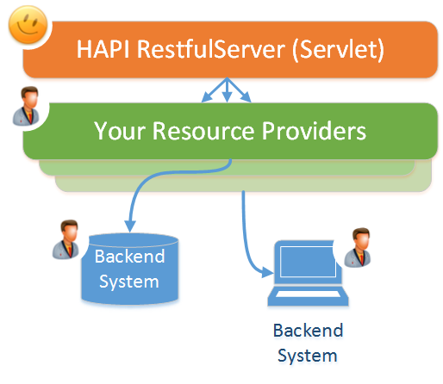
FHIR Server: Architecture (2)
Architecture is based on “Resource Providers” which are custom classes you write to interact with your resources
This is a “low level” API for building servers, not an “off the shelf” solution

Slide 35
FHIR Server:
Defining Resource Providers
Resource Providers are classes you create with specially annotated methods (one class per resource type)
public class Example01_ResourceProviders implements IResourceProvider {
@Read
public Patient read(@IdParam IdDt theId) {
return null; // populate this
}
@Create
void create(@ResourceParam Patient thePatient) {
// save the resource
}
@Search
List<Patient> search(
@OptionalParam(name="family") StringParam theFamily,
@OptionalParam(name="given") StringParam theGiven
) {
return null; // populate this
}
}

Slide 36
FHIR Server:
A Simple Example
The following slides show a simple example building a FHIR server using HAPI
Resources are stored in a HashMap (could just as easily be a database or something else!)
These samples can be downloaded and executed on your laptop very easily

Slide 37
FHIR Server:
A simple resource provider
public class Example02_PatientResourceProvider implements IResourceProvider {
private Map<Long, Patient> myPatients = new HashMap<Long, Patient>();
/** Constructor */
public Example02_PatientResourceProvider() {
Patient pat1 = new Patient();
pat1.addIdentifier().setSystem("http://acme.com/MRNs").setValue("7000135");
pat1.addName().addFamily("Simpson").addGiven("Homer").addGiven("J");
myPatients.put(1L, pat1);
}
/** Simple implementation of the "read" method */
@Read()
public Patient read(@IdParam IdDt theId) {
Patient retVal = myPatients.get(theId.getIdPartAsLong());
if (retVal == null) {
throw new ResourceNotFoundException(theId);
}
return retVal;
}
}
https://github.com/jamesagnew/hapi-fhir/tree/master/hapi-fhir-tutorial/simple-server

Slide 38
FHIR Server:
A simple server
The servlet is very simple: it creates an instance of each resource provider and declares the servlet path
@WebServlet("/example02/*")
public class Example02_SimpleRestfulServer extends RestfulServer {
private static final long serialVersionUID = 1L;
@Override
protected void initialize() throws ServletException {
setResourceProviders(new Example02_PatientResourceProvider());
}
}
https://github.com/jamesagnew/hapi-fhir/tree/master/hapi-fhir-tutorial/simple-server

Slide 39
FHIR Server:
Trying the server out
Console 1: Start Server
james$ mvn jetty:run
[INFO] Scanning for projects...
2014-11-21 12:27:37.622:WARN:oejsh.RequestLogHandler:main: !RequestLog
2014-11-21 12:27:37.669:INFO:oejs.ServerConnector:main: Started ServerConnect
[INFO] Started Jetty Server
Console 2: Try it out!
james$ curl “http://localhost:8080/example02/Patient/1"
<Patient xmlns="http://hl7.org/fhir"><identifier><system value="http://acme.com/MRNs"/><value value="7000135"/></identifier><name><family value="Simpson"/><given value="Homer"/><given value="J"/></name></Patient>

Slide 40
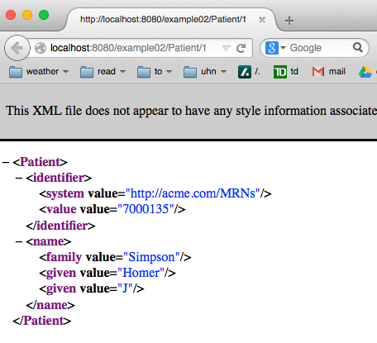
FHIR Server:
Trying the server out (2)
Console 1: Start Server

Slide 41
FHIR Server:
Adding Create and Search
public class Example03_PatientResourceProvider implements IResourceProvider {
// [ … some methods not shown … ]
@Create
public MethodOutcome create(@ResourceParam Patient thePatient) {
// Give the resource the next sequential ID
long id = myNextId++;
thePatient.setId(new IdDt(id));
// Store the resource in memory
myPatients.put(id, thePatient);
// Inform the server of the ID for the newly stored resource
return new MethodOutcome(thePatient.getId());
}
@Search
public List<Patient> search() {
List<Patient> retVal = new ArrayList<Patient>();
retVal.addAll(myPatients.values());
return retVal;
}
}
https://github.com/jamesagnew/hapi-fhir/tree/master/hapi-fhir-tutorial/simple-server

Slide 42
FHIR Server:
Testing out Create
The following command executes a ‘create’
curl -H "Content-Type: application/xml+fhir" \
-X POST \
-d '<Patient xmlns="http://hl7.org/fhir"><name><family value="Fireman"/><given value="John"/></name></Patient>' \
"http://localhost:8080/example03/Patient"
Now perform a search
$ curl “http://localhost:8080/example03/Patient?_pretty=true”
<feed xmlns="http://www.w3.org/2005/Atom">
<os:totalResults>2</os:totalResults>
<entry>
<title>Patient 1</title>
[ … snip … ]

Slide 43
FHIR Server:
Adding Search Params
http://acme.com/Patient?family=SMITH
@Search
public List<Patient> search(@RequiredParam(name="family") StringParam theParam) {
List<Patient> retVal = new ArrayList<Patient>();
// Loop through the patients looking for matches
for (Patient next : myPatients.values()) {
String familyName = next.getNameFirstRep().getFamilyAsSingleString().toLowerCase();
if (familyName.contains(theParam.getValue().toLowerCase()) == false) {
continue;
}
retVal.add(next);
}
return retVal;
}
https://github.com/jamesagnew/hapi-fhir/tree/master/hapi-fhir-tutorial/simple-server

Slide 44
FHIR Server:
Much more is available
Combining multiple parameters
Parameters for sorting, limiting, paging, etc.

Slide 45
FHIR Server:
Learn More
Implementing a server which supports the full FHIR functionality is tricky! For some good insight, please attend “FHIR Search for Server Developers” in Q4
https://github.com/jamesagnew/hapi-fhir/tree/master/hapi-fhir-tutorial/simple-server

Slide 46

HAPI: The Key Components
Structure Classes (represent FHIR model)
Parsers (convert model into XML/JSON)
Client (use HTTP to access FHIR servers)
Server (build a FHIR server)
Utilities:
Validator
Narrative Generator

Slide 47
FHIR Validation
FHIR distributes a set of Schema (XSD) and Schematron (SCH) files containing FHIR validation rules
These are included with HAPI and may be applied using the validation framework
Rules include:
Coded element must have valid code
Date “from” must be before date “to”

Slide 48
FHIR Validation:
A simple example
public class Example08_ValidateResource {
public static void main(String[] args) {
// Create an encounter with an invalid status and no class
Encounter enc = new Encounter();
enc.getStatus().setValueAsString("invalid_status");
// Create a new validator
FhirContext ctx = new FhirContext();
FhirValidator validator = ctx.newValidator();
// Did we succeed?
ValidationResult result = validator.validateWithResult(enc);
System.out.println("Success: " + result.isSuccessful());
// What was the result
OperationOutcome outcome = result.getOperationOutcome();
IParser parser = ctx.newXmlParser().setPrettyPrint(true);
System.out.println(parser.encodeResourceToString(outcome));
}
}
https://github.com/jamesagnew/hapi-fhir/tree/master/hapi-fhir-tutorial/skeleton-project

Slide 49
FHIR Validation:
A simple example
<OperationOutcome xmlns="http://hl7.org/fhir">
<issue>
<severity value="error"/>
<details value="cvc-enumeration-valid: Value 'invalid_status' is not facet-valid with respect to enumeration '[planned, in progress, onleave, finished, cancelled]'. It must be a value from the enumeration."/>
<location value="Line[1] Col[72]"/>
</issue>
<issue>
<severity value="error"/>
<details value="cvc-attribute.3: The value 'invalid_status' of attribute 'value' on element 'status' is not valid with respect to its type, 'EncounterState-list'."/>
<location value="Line[1] Col[72]"/>
</issue>
<issue>
<severity value="error"/>
<details value="cvc-complex-type.2.4.b: The content of element 'Encounter' is not complete. One of '{&quot;http://hl7.org/fhir&quot;:class}' is expected."/>
<location value="Line[1] Col[84]"/>
</issue>
</OperationOutcome>
public class Example08_ValidateResource {
public static void main(String[] args) {
// Create an encounter with an invalid status and no class
Encounter enc = new Encounter();
enc.getStatus().setValueAsString("invalid_status");
// Create a new validator
FhirContext ctx = new FhirContext();
FhirValidator validator = ctx.newValidator();
// Did we succeed?
ValidationResult result = validator.validateWithResult(enc);
System.out.println("Success: " + result.isSuccessful());
// What was the result
OperationOutcome outcome = result.getOperationOutcome();
IParser parser = ctx.newXmlParser().setPrettyPrint(true);
System.out.println(parser.encodeResourceToString(outcome));
}
}

Slide 50
FHIR Validation:
Scope
Validator currently validates against Schema and Schematron only
Still to come:
ValueSet validation
Profile validation
We would love help on these! :)

Slide 51
The Narrative Generator
HAPI comes with a module for generating HTML narratives based on resources
Generator uses Thymeleaf templating engine from http://www.thymeleaf.org/

Slide 52
Using the Narrative Generator
public class Example09_NarrativeGenerator {
public static void main(String[] args) {
// Create an encounter with an invalid status and no class
Patient pat = new Patient();
pat.addName().addFamily("Simpson").addGiven("Homer").addGiven("Jay");
pat.addAddress().addLine("342 Evergreen Terrace").addLine("Springfield");
pat.addIdentifier().setLabel("MRN: 12345");
// Create a new context and enable the narrative generator
FhirContext ctx = new FhirContext();
ctx.setNarrativeGenerator(new DefaultThymeleafNarrativeGenerator());
String res = ctx.newJsonParser().setPrettyPrint(true).encodeResourceToString(pat);
System.out.println(res);
}
}
https://github.com/jamesagnew/hapi-fhir/tree/master/hapi-fhir-tutorial/skeleton-project

Slide 53
Using the Narrative Generator
A narrative generator is configured against a single FhirContext and applies to everything generated by it
public class Example09_NarrativeGenerator {
public static void main(String[] args) {
// Create an encounter with an invalid status and no class
Patient pat = new Patient();
pat.addName().addFamily("Simpson").addGiven("Homer").addGiven("Jay");
pat.addAddress().addLine("342 Evergreen Terrace").addLine("Springfield");
pat.addIdentifier().setLabel("MRN: 12345");
// Create a new context and enable the narrative generator
FhirContext ctx = new FhirContext();
ctx.setNarrativeGenerator(new DefaultThymeleafNarrativeGenerator());
String res = ctx.newJsonParser().setPrettyPrint(true).encodeResourceToString(pat);
System.out.println(res);
}
}
https://github.com/jamesagnew/hapi-fhir/tree/master/hapi-fhir-tutorial/skeleton-project

Slide 54
Using the Narrative Generator
[ … snip … ]
<div><div class=\"hapiHeaderText\"> Homer Jay <b>SIMPSON </b></div><table class=\"hapiPropertyTable\"><tbody><tr><td>Identifier</td><td>MRN: 12345</td></tr><tr><td>Address</td><td><span>342 Evergreen Terrace </span><br/><span>Springfield </span><br/></td></tr></tbody></table></div>
[ … snip … ]
public class Example09_NarrativeGenerator {
public static void main(String[] args) {
// Create an encounter with an invalid status and no class
Patient pat = new Patient();
pat.addName().addFamily("Simpson").addGiven("Homer").addGiven("Jay");
pat.addAddress().addLine("342 Evergreen Terrace").addLine("Springfield");
pat.addIdentifier().setLabel("MRN: 12345");
// Create a new context and enable the narrative generator
FhirContext ctx = new FhirContext();
ctx.setNarrativeGenerator(new DefaultThymeleafNarrativeGenerator());
String res = ctx.newJsonParser().setPrettyPrint(true).encodeResourceToString(pat);
System.out.println(res);
}
}
https://github.com/jamesagnew/hapi-fhir/tree/master/hapi-fhir-tutorial/skeleton-project

Slide 55
Sample Generated Narrative
Generated narratives can be seen on our test server: http://fhirtest.uhn.ca/read?serverId=home&resource=DiagnosticReport&action=read&id=84&vid=1

Slide 56
Extensions: The Easy Way
Every element has a collection of “undeclared” extensions
public class Example10_Extensions {
public static void main(String[] args) {
Patient pat = new Patient();
pat.addName().addFamily("Simpson").addGiven("Homer");
String url = "http://acme.org#eyeColour";
boolean isModifier = false;
pat.addUndeclaredExtension(isModifier, url).setValue(new CodeDt(“blue"));
IParser p = new FhirContext().newXmlParser().setPrettyPrint(true);
String encoded = p.encodeResourceToString(pat);
System.out.println(encoded);
}
}

Slide 57
Extensions: The Easy Way
Every element has a collection of “undeclared” extensions
<Patient xmlns="http://hl7.org/fhir">
<extension url="http://acme.org#eyeColour">
<valueCode value="blue"/>
</extension>
<name>
<family value="Simpson"/>
<given value="Homer"/>
</name>
</Patient>
public class Example10_Extensions {
public static void main(String[] args) {
Patient pat = new Patient();
pat.addName().addFamily("Simpson").addGiven("Homer");
String url = "http://acme.org#eyeColour";
boolean isModifier = false;
pat.addUndeclaredExtension(isModifier, url).setValue(new CodeDt(“blue"));
IParser p = new FhirContext().newXmlParser().setPrettyPrint(true);
String encoded = p.encodeResourceToString(pat);
System.out.println(encoded);
}
}

Slide 58
Extensions: The “Hard” Way
HAPI also provides a set of annotations for creating statically typed extensions
@ResourceDef(name="Patient")
public class Example11_ExtendedPatient extends Patient {
@Child(name = "eyeColour")
@Extension(url="http://acme.org/#extpt", definedLocally = false, isModifier = false)
private CodeDt myEyeColour;
public CodeDt getEyeColour() {
if (myEyeColour == null) {
myEyeColour = new CodeDt();
}
return myEyeColour;
}
public void setEyeColour(CodeDt theEyeColour) {
myEyeColour = theEyeColour;
}
}

Slide 59
Get Help!
See our website for documentation: http://jamesagnew.github.io/hapi-fhir/
We also have a Google Group / Mailing List https://groups.google.com/d/forum/hapi-fhir

Slide 60
Get Involved!
HAPI is a large worldwide community of developers
Today most are working on HL7 v2, but this is changing fast
We are very grateful to the many people who have contributed so far, maybe you could be next?

Slide 61
HAPI: Other Topics
Web Testing UI: The testing interface shown on our test server may be added to your own server
JPA: HAPI has a JPA module which stores and indexes resources in a relational database using Hibernate

Slide 62
Thank You!
jamesagnew@gmail.com
jamesagnew214 on Skype

